Slide 1
Open Enrollment Information
2018

Slide 2
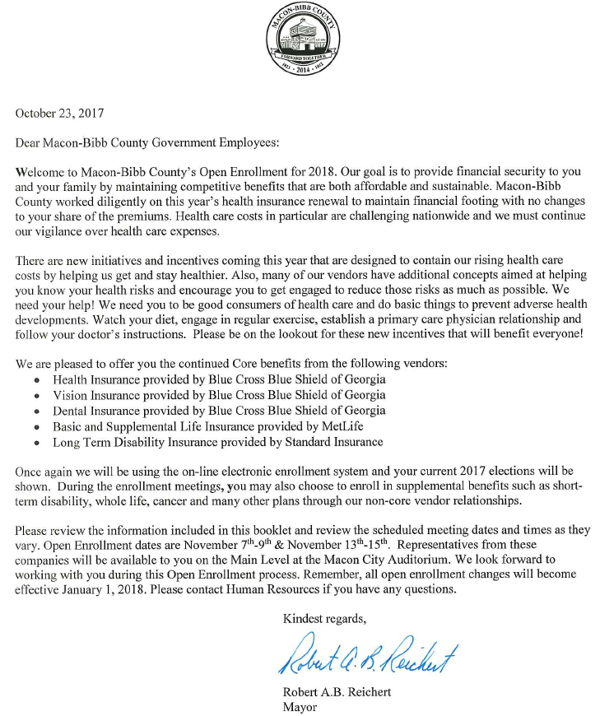

Slide 3
Medical Cost
Medical plan costs are challenging and increasing.
How have your costs been going?
2015 $20,935,892
2016 $20,666,478
2017 $25,079,918 (Projected)
What has impacted your cost?
Maternity claims are up.
Emergency Room and Outpatient Claims are Up
Prescription Drug Costs are Up
Increase in Cancer patients along with their associated costs

Slide 4
Your Choices Matter
You need to Seek Medical Care:
For the Right Treatment
At The Right Time
At The Right Place
Doing the right thing impacts your health and the associated cost of medical care.
Participate in Wellness activities brought to you through:
Macon-Bibb County Healthier-Making Better Choices

Slide 5
Your Choices Matter
Current average claim costs:
Emergency Room: $1,336
Urgent Care: $221
Doctor’s Visit: $125
Renewal Plan Modifications:
Emergency Room Cost: $200 or $300 depending on your plan design.
Urgent Care: $50 copay
Primary Care Physician: $25 copay (on average)
Live Health: $0.00 (FREE)

Slide 7
Plan Design Highlights In-Network Benefits
HMO $500
$500 Deductible, then 80/20 split
$2,500 Out of Pocket Maximum
Copays:
$20 PCP/$45 Specialist
Rx: $10/$30/$50
ER: $200, UC: $35, Live Health: $0
POS $1,000
$1,000 Deductible, then 80/20 split
$3,500 Out of Pocket Maximum
Copays:
$30 PCP/$60 Specialist
Rx: $10/$30/$60
ER: $300, UC: $50, Live Health: $0
POS $500
$500 Deductible, then 80/20 split
$3,000 Out of Pocket Maximum
Copays:
$25 PCP/$50 Specialist
Rx: $10/$30/$50
ER: $300, UC: $50, Live Health: $0

Slide 8
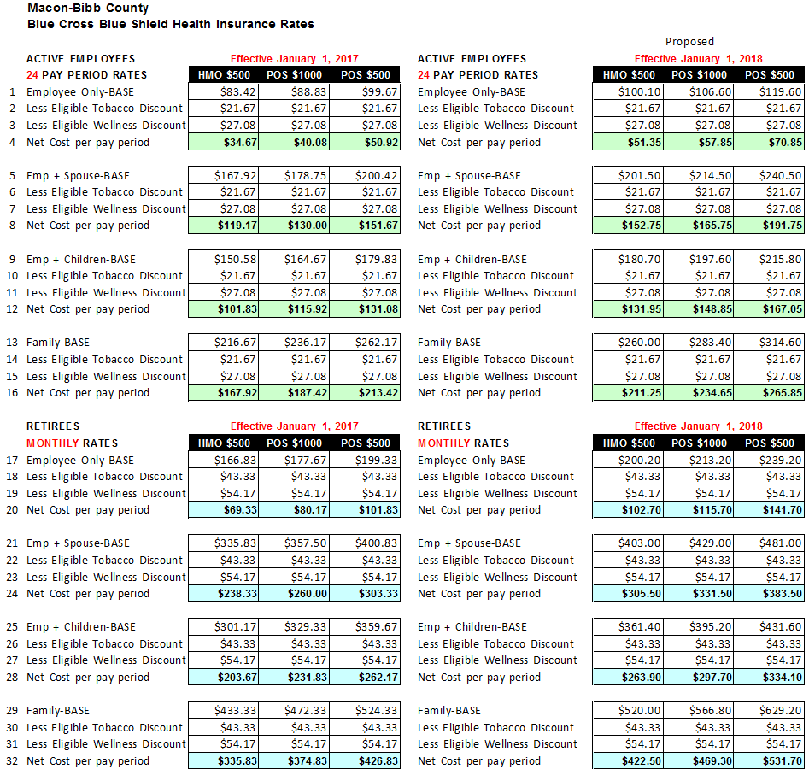
Rates

Slide 9
Wellness and Non-Tobacco Use Discounts
Discounts for Non-Tobacco use will continue unchanged.
Discounts for having an annual check-up will continue unchanged.
See Page 8 of your guide.

Slide 10
Can I Still Use My Doctor?
No changes in the Provider Network.
But occasionally a physician will drop out of the Network.
Important to check Network status before receiving care.
Remember that HMO option requires use of Network providers.

Slide 11
Provider Search Instructions on Page 11

Slide 12
LiveHealth Online Page 7 of Guide

Slide 13
LiveHealth Online Page 7 of Guide
See a Doctor 24/7 in minutes for non-emergency use.
Board-certified doctors
Available thru smartphone, tablet or computer with a webcam.
Can order prescriptions as needed.
Cost=$0 copay
Pre-registering recommended for ease of use when you need a doctor.

Slide 14
Dental Insurance
Renewing with Blue Cross
No Change in Benefits
BI-WEEKLY RATES:
Single Employee $12.56
Employee + 1 dep $25.19
Employee + 2 or more $41.08
Dental Plan Details on Pages 19-21

Slide 15
Dental Benefit Review
Network of preferred dentists
Benefits are the same In and Out of Network
But pricing is pre-negotiated with Network dentists and can save you money.
No risk of “balance billing” when charged more than normal rate
FIND A DENTIST: www.bcbsga.com or call the number on your ID card.

Slide 16
Dental Benefits Pages 19-21 of Guide
Annual Benefit Maximum $1,500
Ortho lifetime benefit $1,500
Deductible: $50 per person
Family Deductible: $150
Preventive Care covered at 100% and deductible doesn’t apply.
Basic services covered at 80%
Major services covered at 50%
Orthodontia covered at 50%
See Limitations and Exclusions section on page 17.

Slide 17
Vision Insurance
Provided by Blue Cross
No change to benefits or rates
BI-WEEKLY RATES:
Single Employee $2.48
Employee + Spouse $4.36
Employee + Children $4.73
Family $7.21
Vision Plan Details on Page 22

Slide 18
Vision Plan Benefits on Page 22 of Guide

Slide 19
Vision Overview In-Network Benefits
Annual Exam covered after $10 Co-pay
Lenses covered annually after $20 Co-pay
Contacts covered annually up to $130 retail allowance. No Co-pay
Choose either lenses or contacts, but both not covered.
Frames covered annually up to $130 retail allowance.

Slide 20
Long Term Disability Page 23-24 of Guide
Continuing with The Standard Insurance Company
No change in benefits
No change in rates, but total premium changes if your base pay changes.

Slide 21
Life Insurance Information Page 25 of Guide

Slide 22
Group Life Insurance
MetLife is the Life Insurance Carrier
County Provided Life Benefit for ACTIVE employees depends on hire date and former employer (City or County)
County Provide Life Benefit for RETIREES depends on hire date and former employer (City or County)
Supplemental life insurance is available for yourself, your spouse and/or your children under age 26.

Slide 23
Supplemental Life Insurance
Eligible to Buy on yourself amounts up to 5 X Salary in $10,000 increments not to exceed $500,000
Rate based on your age on 1/1/18
Rates change as you get older
Eligible to Buy on your spouse amounts up to $250,000 in $10,000 increments.
Eligible to Buy either $10,000 or $20,000 on your children.
Purchase of coverage on spouse or children requires at least minimum purchase of $10,000 on yourself.

Slide 24
Beneficiary Designations
You can change your life insurance beneficiary at any time.
Remember to keep this up to date especially when life events occur such as:
Marriage
Divorce
Birth of a child
Death of a beneficiary

Slide 25
Electronic Enrollment Process
Sign on at www.maconbibbbenefits.com
The On-Line System will be available to sign on Tuesday November 14, 2017.
You will have access from your office, home computer or the 11th floor of the Macon-Bibb Human Resources Training Center
The system will be Open from November 14th to November 22nd
First time users must Register first by checking “Click here to register”.
Answer 5 security questions designed to protect your personal information.
Click on “Open Enrollment” then click on “Go to the Enrollment System”.

Slide 26
Wellness
Gym memberships available through Kinetix and Navicent Health
Cost per Month:
$12.00 for Kinetix
$24.40 for Navicent
Flu shots today provided by Macon Occupational Medicine.

Slide 27
Additional Opportunities
AFLAC
Cancer
Hospital Intensive Care
Short Term Disability
Accident and Critical Illness
Hospital Indemnity
Allstate
Life Insurance
Short Term Disability

Slide 28
Additional Opportunities Continued
Colonial Life
Hospitalization
Cancer
Short Term Disability
Accident
Critical Care
Principal Financial Group
Short Term Disability
Transamerica
Life Insurance

Slide 29
Additional Opportunities Continued
LegalShield
Legal Services
Identity theft protection
Liberty National Life
Life Insurance
Mass Mutual Financial Group
- Whole Life Insurance
BLUE CROSS BLUE SHIELD
Medicare Supplemental Insurance
They’re all here for You!
Go visit with them and see what’s available.

Slide 30
Vendors On-site
Vendors are on-site.
Some of the vendors are giving away door prizes! Be sure to register for your chance to win.
Make Sure you Check In with Macon-Bibb HR at front tables to be eligible for Door Prizes.

